Slide 1
Professional Ethics
NEED OF HOUR IN INDIA
An Analysis by Amit Yadav & Kapil Agarwal

Slide 2
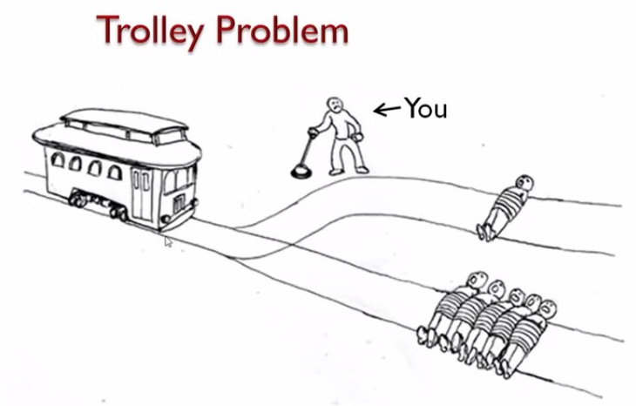
Choice:
1. Pull the lever to save five people, but the another person will die.
2. Don't pull the lever and let the five people die
Notes:
Let’s start with a problem which is a moral dilemma –
In this problem, there is a man standing at the lever. The lever controls the path of the trolly which will go on one of the two tracks according to how he acts.
If he doesn’t pull the lever, trolley will continue on its original track and run over five people and kill them. If he choose to pull the lever the track will be changed, the trolly will run over only one person, resulting in killing him. So he has two choices –
a). He can choose to pull the lever and save five people but one person will die.
b). He can choose to not pull the lever and let the five people die.
Let’s consider this problem with different theories -

Slide 3
Consequentialism
Outcome-based theory:
“We should save the life of as many people as possible, even if that means others die.“
Choice: Pull the lever.
Notes:
First, Let’s consider this outcome based theory – Which states that we should save the life of as many people possible.. According to this theory We will choose to “Pull the lever”.

Slide 4
Deontology
Rule or obligation-based theory:
“We should not choose to kill someone without their permission.“
Choice: Don't pull the lever.
Notes:
Let’s consider an alternative theory which is a rule or obligation based theory and this theory stats that we should not choose to kill someone without their permission. So, acc. To this theory – We “Don’t pull the lever”.

Slide 5
Virtue Ethics
Character-based theory:
"Whatever the action, what does it say about you? What is the intention or benefits?"
Choice: Either?
Notes:
Now, Let’s consider one more theory – Virtue Ethics
It is a character based theory. It asks questions like – Whatever the action he takes, what does it say about us? What is the intentions or benefits ?
In this sense, Virtue ethics does not gives us any guidance – Choice could be ethier. It will depends upon the character of the person taking the decision.
So, In every walk of life, We are expected to behave in particular manner. We may be in a family, a group, an organization, a profession or anywhere ; there are some guidelines which guide us how to behave or interact.
We will see how ethics will help us in the same -

Slide 6
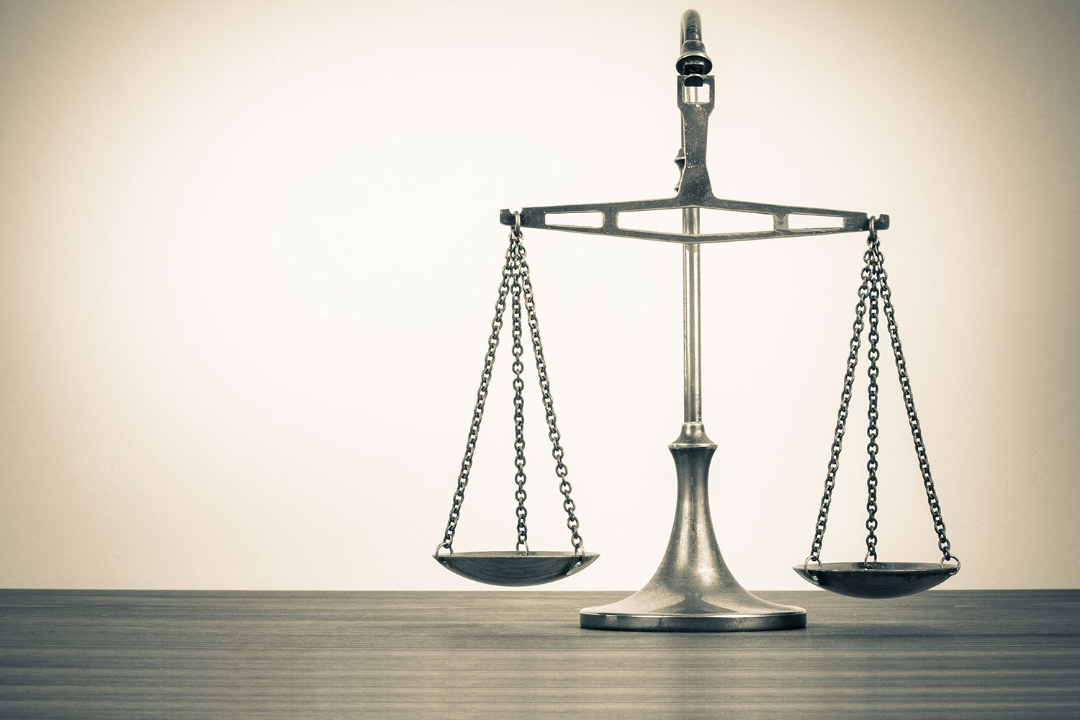
What is Ethics?
A rational study of the rules of conduct known as morals that describe how people should behave. Each of us has such a set of moral values.
Notes:
It is a rational study of the rules of conduct known as morals that describe how people should behave. It helps us making a distinction between - What is good and what is bad.

Slide 7
Professional Ethics It is the personal, organizational and corporate standards of behavior expected of the members of a particular profession.
Notes:
Let’s move to our topic which is professional ethics. PRO ETHICS is the personal and corporate standard of behavior expected from professionals.

Slide 8
Golden rules of Professional Ethics
Always strive for excellence
Be trustworthy
Be honest, open and transparent
Be courteous and respectful
Always be ethical
Be respectful of confidentiality
Set good examples
Be competent and improve continually
Notes:
Golden Rules of Professional Ethics:
We should always strive for achieving greatness. Excellence is a quality which surpasses ordinary standards. We should make a habit for it to make a good impression on our bosses and colleagues.
In today’s society trust is an issue and any employee who exhibits trustworthiness is on a fast track to professionalism. Trustworthiness is about fulfilling an assigned task on time and not letting down expectations.
Honesty is a facet of moral characters which shows straightforwardness and fairness.
Courteousness is being friendly, polite and mannered towards others. It makes social interactions in the workplace run smoothly. We should avoid conflicts and earn respect.
Ethical behavior is acting within certain moral codes. It is always safe for an employee to “play by the rules”.
Confidentiality is respecting the set of rules or promise that restricts you from further and unauthorized dissemination of information.
We must show and lead by good example.
Competence is the ability of an individual to do a job properly. It is a combination of knowledge, skills and behavior used to improve performance.

Slide 9
Code of Ethics
A written set of guidelines issue by an organization to its workers and management to help them conduct their actions in accordance with its primary values and ethical standards.
Both businesses and trade organizations have some sort of code of ethics that its employees or members are supposed to follow.
Notes:
Code of Ethics are written set of guidelines issued by organizations to it’s workers. It provides the basic framework for the ethical judgement for professionals.
The codes help the professionals to apply moral and ethical principles to the specific situations.

Slide 10
Advantage of Code of Ethics
It provides explicit guidance to managers and employees.
It provides positive and potential support to new employees to perform their duties in ethical manner
It enhances the organization's reputation and inspires public confidence .
It raise awareness and consciousness of issues.

Slide 11
Limitations of Code of Ethics
Misinterpretation of code.
Introducing and implementing the code effectively will be demanding of senior management time.
Increase in expectation level.
Codes of ethics are broad guidelines, restricted to general phrases. The codes cannot be applied directly to all situations.

Slide 12

Ethical Issues
Law vs Ethics Behavior can be unethical without being illegal, and professional ethics covers a wider area than the law.
An attitude of mind Claiming expenses for amounts that have not been incurred or were incurred for personal rather than business use might be considered unethical by most but what about the taking home pens, paper and other stationary from office.
Conflicts of interest Protecting the interests of others rather than themselves.
Ethical Dilemma Eg. Personal ethics conflicting with professional at workplace

Slide 13
Need of hour in INDIA

Slide 14
Need in India
Developing countries like India can be damaged by poor professional ethics.
India as a whole is held back by companies operating without professional ethics.
Constant striving for better and more ethical dealings in business produces a cycle of continuous improvement.
Without the ethical approach sustainability will fail and future generations will suffer.
Notes:
There is a serious need of Professional Ethics in India.
These are some reasons behind this --
Developing Countries like India can be damaged by poor professional ethics.
India is held back by companies operating without professional ethics.
Constant efforts for better and ethical dealings in business produces a cycle of continuous improvement.
Without the ethical approach the sustainability will fail and future generations will suffer.

Slide 15
Bribery and Corruption in India
Strain on ethical behaviour
Taking the easy way out
Challenging times ahead
Need for greater enforcement of laws
Notes:
Strain on ethical behavior: It has been seen that a large no of people are comfortable with (or were aware of) unethical business conduct. These include hiding bribery and corruption, gifts being given to seek favours.
Taking the easy way out: More than half of the respondents agreed that it is the lack of will to obtain licenses and approvals the “right way,” which leads to bribery and corruption.
AMIT
Challenging times ahead: Around 83% of the respondents felt that cases of bribery and corruption can negatively impact FDI inflows.
Need for greater enforcement of laws: Around 89% of the respondents felt that there should be greater enforcement of laws to curb the proliferation of bribery and corruption.

Slide 16
Steps Taken
Social Work Educators’ forum (SWEF) at TISS , declared a code of ethics for professional social workers in India.
Adoption of Information and Communication Technology - e-governance as master key to good governance.
Indian Companies Act mandates increased corporate transparency and accountability
The Companies Bill, 2009, has introduced the concept of ‘Corporate Social Responsibility’ (CSR) into Indian company law.
Notes:
These are some steps taken in this matter:
This draft of 'Declaration of Ethics for Professional Social Workers' has been prepared by the Social Work Educators' Forum (SWEF) at the Tata Institute of Social Sciences.
The Declaration of Ethics for Professional Social Workers is intended to serve as a guide to the members of the social work profession, who have obtained minimally a bachelor's degree in social work and, thus, base their work on recognised knowledge, philosophy and skills.

Slide 17

Wal-Mart Store
A Case of Employee Discrimination
Notes:
Now lets have a look on few case studies of professional misconduct.
Wal-Mart--
Wal-Mart Stores, Inc is an American biggest public corporation, and it is the largest grocery retail company throughout the world. They uses a low-price strategy to operate its business.
It has been a subject to sustained criticism due to some Unethical practices like Child Labor, Health Concerns, Racial Discrimination and Environmental issues.
First one is Deborah Shank's brain damaged case:
He was a Wal-Mart employee, who suffered a miserable collision with a truck in many years ago, and due to this, she got a permanent brain damage. She involved in Wal-Mart health-care plan, she got her initial medical payments from wal-mart.
Wal-Mart wanted to withdraw the expenses, bcoz Shank family got the compensation from trucking company. Shank family sued by Wal-Mart, and requested the couple to pay back the whole money. The US Supreme court judged in favour of Wal-Mart. After publishing of this news, large number of citizens were indigent about the company inappropriate behavior and tried to boycott the company.
In turn, Company modified their health-care plan, cancel those refunds.
Child Labor:
Walmart become cause using Slave Child Labor of your supplier, because they require high capacity of order in short time in very low even less then at wholesale price, therefore its supplier use slave child labor at very low wage rate and provide maximum material.

Slide 18

Snapchat shares drop following CEO's alleged “Poor India" comment.
Twitter Hashtag: #boycottsnapchat
1.5% Fall in Shares
Notes:
Few days back Evan Spiegel alleged to have said that “Snapchat is for rich people and I don’t want to expand to poor countries like India and Spain.”
This news was shared somewhere on Social Media and went viral, people started uninstalling the Snapchat app and they twitted the pictures uninstalling the app using hashtag #boycottsnapchat and this resulted a huge loss for Snapchat. It’s shares dropped by 1.5% and within 24 hrs and it’s rating also reduced to 1 Star in the Apple App Store.

Slide 19
Action Required
Expand Boundaries of RTI and ensure speedy disposal through e-governance.
Make ethical aspects part of any training program.
Should stop state funding of Elections.
Ethical behaviour be reflected in legal framework.

Slide 20
Thank you!

